Slide 1
Industry-Government Engagement Workshop A-E Cost Engineering Challenges Tulsa, OK
19 March 2019

Slide 2
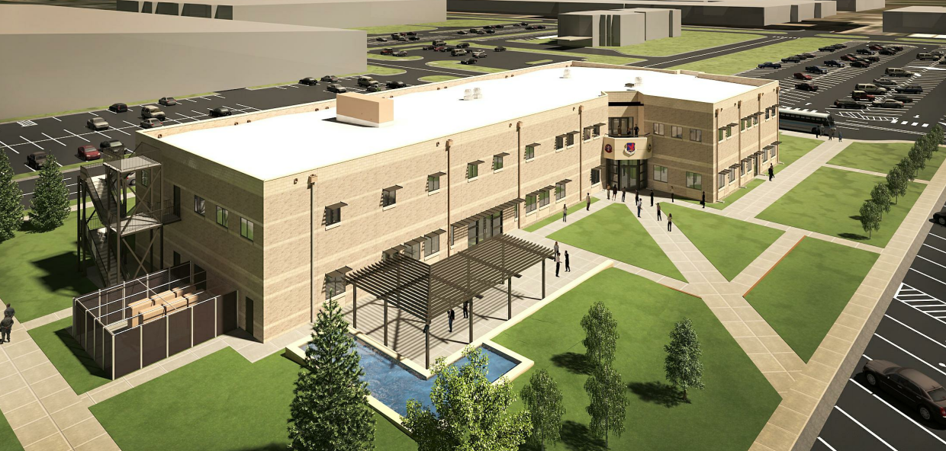
Discussion Topics
FAR 52.236-22 Design Within Funding Limitations
Proactive Project Cost Control During Design
Project Programming

Slide 3
FAR 52.236-22 Design Within Funding Limitations
(a) The Contractor shall accomplish the design services required under this contract so as to permit the award of a contract, using standard Federal Acquisition Regulation procedures for the construction of the facilities designed at a price that does not exceed the estimated construction contract price as set forth in paragraph (c) below. When bids or proposals for the construction contract are received that exceed the estimated price, the contractor shall perform such redesign and other services as are necessary to permit contract award within the funding limitation. These additional services shall be performed at no increase in the price of this contract. However, the Contractor shall not be required to perform such additional services at no cost to the Government if the unfavorable bids or proposals are the result of conditions beyond its reasonable control.
(b) The Contractor will promptly advise the Contracting Officer if it finds that the project being designed will exceed or is likely to exceed the funding limitations and it is unable to design a usable facility within these limitations. Upon receipt of such information, the Contracting Officer will review the Contractor's revised estimate of construction cost. The Government may, if it determines that the estimated construction contract price set forth in this contract is so low that award of a construction contract not in excess of such estimate is improbable, authorize a change in scope or materials as required to reduce the estimated construction cost to an amount within the estimated construction contract price set forth in paragraph (c) below, or the Government may adjust such estimated construction contract price. When bids or proposals are not solicited or are unreasonably delayed, the Government shall prepare an estimate of constructing the design submitted and such estimate shall be used in lieu of bids or proposals to determine compliance with the funding limitation.
(c) The estimated construction contract price for the project described in this contract is $____.
designed at a price that does not exceed the estimated construction contract price
exceed the estimated price, the contractor shall perform such redesign and other services as are necessary to permit contract award within the funding limitation.
unfavorable bids or proposals are the result of conditions beyond its reasonable control.
promptly advise the Contracting Officer… exceed or is likely to exceed the funding limitations and it is unable to design a usable facility within these limitations.

Slide 4
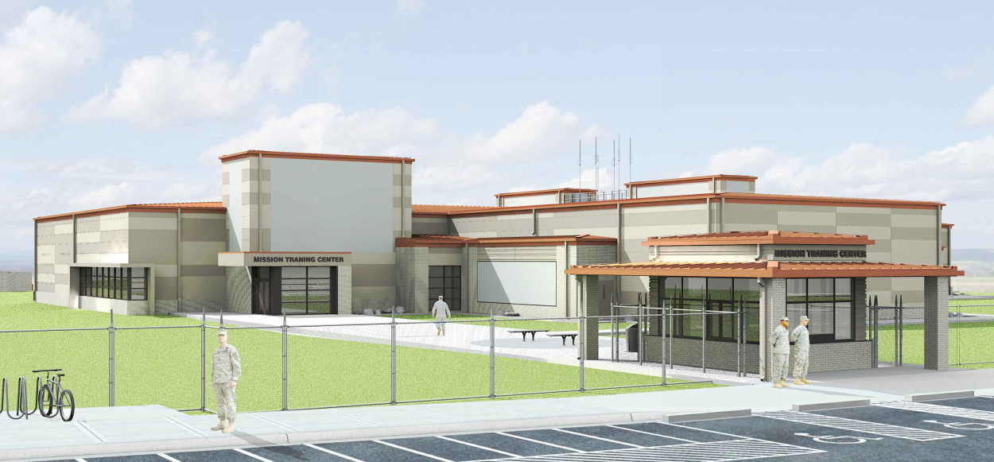
Proactive Project Cost Control During Design
Starts At The Charrette
Aggressive Base Bid
Target 80% Of Construction Cost Limit
Target 75% Of Square Footage
Facility Still Required To Meet Mission Minimum Requirements
Options To Full Scope
Need Support From USACE And Air Force With The Installation.
Further Design As Far As Possible During The Charrette
FAR 52.236-22 (a): “designed at a price that does not exceed the estimated construction contract price “
FAR 52.236-22 (b): “promptly advise the Contracting Officer… exceed or is likely to exceed the funding limitations and it is unable to design a usable facility within these limitations. “

Slide 5
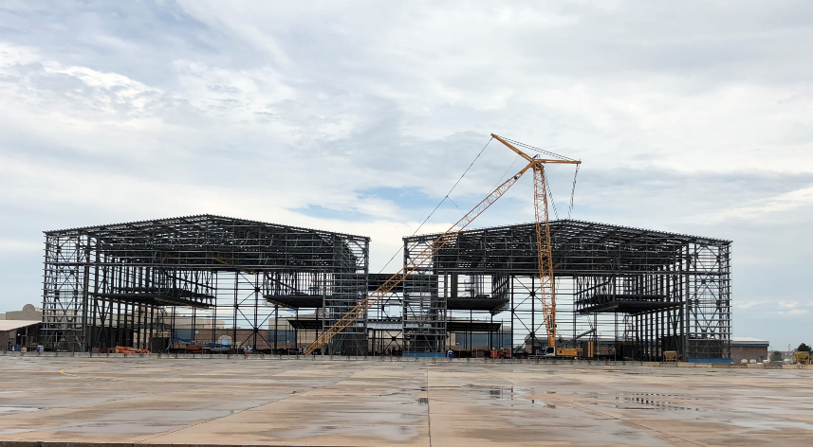
Proactive Project Cost Control During Design
Proactive Approach will Save Time
Quality of Design Concerns if not Proactive in Cost Control
FAR 52.236-22 (a): “exceed the estimated price, the contractor shall perform such redesign and other services as are necessary to permit contract award within the funding limitation. “

Slide 6
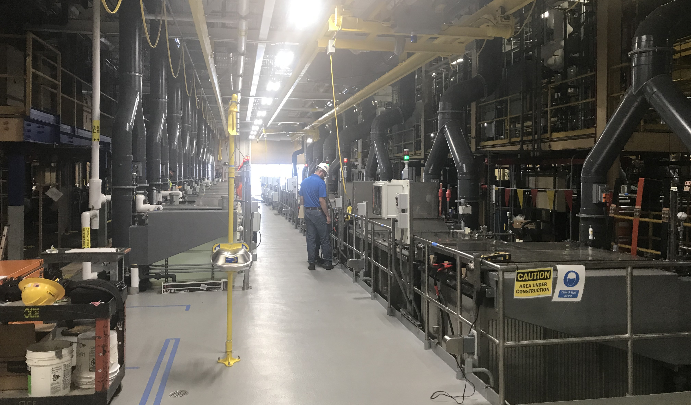
Project Programming
Most Times The Funding Is Locked In Well Before Design Starts.
Industry Changes Faster Than Project Funding Allows
When Design Starts the A-E’s Can Only Try To Control Scope.
Helpful Resources for Programming – A-E’s and USACE
MILCON, SRM & CIP Funded Projects
Concern with missing:
Contractor Markups Not Correct
Productivity Of Contractors
Missing USACE Construction And Engineering Support
Missing Infrastructure Requirements To Support The Facility

Slide 7
Thank You

